Slide 1
RVW Model – Productivity Improvements (Design workbench)
Aviation Product Development : Oct 2022

Slide 2
Design Workbench
Conducted a survey across the team to collect platform productivity related improvements
Prioritized specific feedback
Productivity impacted extremely due to approach of clarifying issues rather than preventive defect fixing for lack of validations
Publish ECR
Code gen
Baselining and Handle Changes
Usability Issues
Understanding/ Lack of Clarity/Not used

Slide 3
Topic 1 : Statistics and Analysis – Clarifications
Pattern 1 : Defect in Model application. Validation to be added.
# | Issue | Clarified Solution | RCA | Tech Ref.
1 | On click of Get price task, quantity value passed wrongly. | Incorrect default value mapped for segment data items. | System allowed to define incorrect default value for numeric fields | TECH-73518
2 | Getting Error while launching Help on MR planning pop up | Hidden view mapped to the list control which needs to be removed. | System allowed to define hidden view for list view control in manage hidden view screen. But Tech team asked us to remove. | TECH-72956
3 | Codegen failed | List view modelling is incomplete. List view control has been added but there is no columns defined | System allowed to publish the ECR without mapping for List view columns. | TECH-72725
4 | Mouse Hover is not working for Tree grid multiline columns. | Issue resolved after properly mapped the controls in attribute mapping | Issue in "Control - Attribute Mapping" screen in Hub version. It is not saving the records based on our selection. Tech team suggested to do this mapping alone in old Extui version. | TECH-72476

Slide 4
Topic 1 : Statistics and Analysis – Clarifications
Pattern 1 : Defect in Model application. Validation to be added.
# | Issue | Clarified Solution | RCA | Tech Ref.
5 | List View is not working | Segment "Symbol_Seg " is single segment. kindly map multi segment for list view control | System allowed to map the single segment dataitem for listview control. But it should allow only for multi segment data items. | TECH-69657
6 | Codegen failed | Codegen failed due to invalid control attribute mapping | System is not validated this invalid control attribute mapping in publish ECR | TECH-69420
7 | Codegen failed | List view modelling is incomplete. LVWMHI_Symbolcode_Combo is involved in publication dataitem which should not be done | System allowed to publish the ECR and not validated. | TECH-69282
8 | While publishing the ecr getting the mentioned error. | Kindly map the Business term for the synonym "desc40" | Error meesage not coming with Activity - UI information. It will be difficult to resolve without Tech help. | TECH-72064
Solution :
Necessary validation to be added in the respective tasks
All these defect are closed with clarification notes. These are defects to be handled in model application

Slide 5
Topic 1 : Statistics and Analysis – Clarifications
Pattern 2 : Issue in Deliverables generation
# | Issue | Clarified Solution | RCA | Tech Ref.
1 | Codegen failed | Code gen schema level changes issue. | Fix applied | TECH-72392
2 | In screen, Value is given in chinese but in trace it is passing as ???????? . | Issue has been resolved after deploying the latest screen deliverables | Generated the deliverables again and deployed | TECH-71571
3 | Unable to launch view associated doc attachments in Maintain alternate part no's screen | Issue has been resolved after regenerating and redeploying the deliverables. | Generated the deliverables again and deployed | TECH-69342
4 | state file is missing in code gen | iRule supporting dll not found. State file generation skipped due to that error. | Issue resolved after deploying the irule generation supporting objects in code gen server. | TECH-72817
5 | Codegen failed | Error due to EDK script generation. | EDK script disabled in AAD new model server for all the components. | TECH-72540

Slide 6
Topic 1 : Statistics and Analysis – Clarifications
Pattern 2 : Issue in Deliverables generation
# | Issue | Clarified Solution | RCA | Tech Ref.
6 | Service are not generated for help and sort Services in Codegen | For the method "M_CC_AuCC_Mul_Met",kindly provide the parameter "ccsheetno" flow direction as in or out. | No error in Publish ECR | TECH-71836
7 | Codegen is getting continuously failed for BASWC component | activity :-WCRwCapCer ; ui:-AdvanceSearch ; section :- RwAsJqurSec control synonym :-RwAs_RulesR in this UI there is a improper rulebuilder control which has no definition of grid and header grid columns | System allowed to publish ECR without definition for grid in rulebuilder. | TECH-71003
8 | Codegen is getting Failed Continuously For BASCONFIG component | Issue resolved after changed the parameter mapping for the service "cfg_mqr_fet_ser" | No error in Publish ECR | TECH-70182
Codegen fixes are applied, and defects are clarified to regenerate the deliverables

Slide 7
Topic 1 : Statistics and Analysis – Clarifications
Pattern 3 : Handle changes errors
# | Issue | Clarified Solution | RCA | Tech Ref.
1 | Getting the mentioned error while launching handle messages-->Message Task mapping tab | Latest model sp's has been compiled. | SQL Defect in Handle changes DB | TECH-72600
2 | Unable to validate Handle changes ECR-getting error on doing validation | ECR has been validated. | SQL Defect in Handle changes DB | TECH-71378
3 | Kindly validate the below ecr in handle changes version : SC_ECR_00680 | ECR has been validated. | SQL Defect in Handle changes DB | TECH-72255
4 | Getting attached error on click of validate in Handle Changes | Issue resolved after mapped proper bt for synonym name. | System allowed to map incorrect bt synonym to BT | TECH-71784
5 | For Scrap parts (APSE-19498) While Publishing this ECR : SPN_ECR_00043 in (Handle Changes 5_7 Dev) error was throwing. | ECR has been validated. | Defect in Handle changes DB | TECH-71164

Slide 8
Topic 1 : Statistics and Analysis – Clarifications
Pattern 3 : Handle changes errors
# | Issue | Clarified Solution | RCA | Tech Ref.
6 | Unable to make solutioning changes in customer ECR in HandleChanges_FS Context | Issue has been resolved after correcting the model sp. | Defect in Handle changes DB | TECH-71021
7 | Getting error on validating in handle changes in rvw | Provided ECR validated | SQL Defect in Handle changes DB | TECH-70981
8 | Unable to publish the ECR in handle changes mode. getting attached error | ECR has been validated after correcting model sp | Defect in Handle changes DB | TECH-69234
9 | Unknown Error on Validate task of Handle Changes ECR | Against the service "cdicmisrcomaddui" there is no process section is defined. Kindly do the same and proceed. | No proper error message to handle on own | TECH-67884
Errors in Handle changes cannot be resolved without Tech’s input

Slide 9
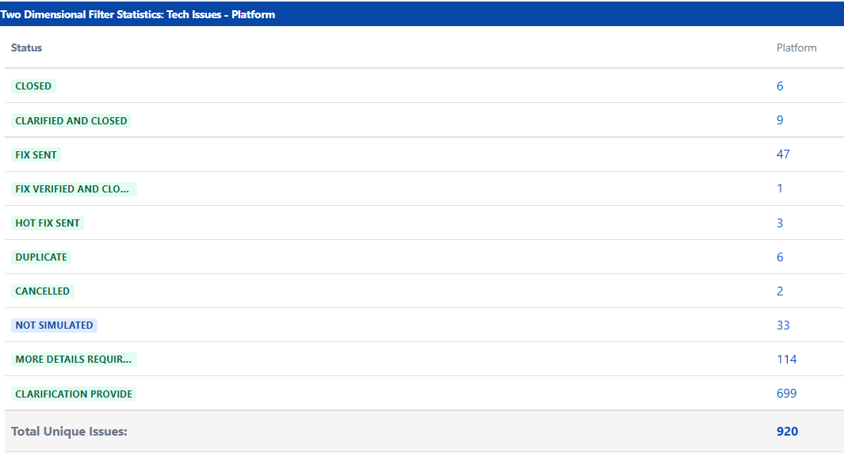
Issues in Platform Aviation – From April ‘22
Very high defect count
Most defects are clarified even if these are lack of adequate controls
What was fixed not shared
Preventive not tracked
Missed opportunity to fix
A controlled fix propagation, verification and RCA process to be mandated

Slide 10
Topic 2 : Publish ECR
Error Handling [ Tech Backlog Ref # : TECHB-924]
Errors are validated one by one, require bulk validations
Impact -> Time consuming to resolve errors one by one
Concurrent management of Publish ECRs [ Tech Backlog Ref # : TECHB-925]
Enable the option to allow Publish ECR for more than one user
Anyway, the ECR publishing can be made offline
---- can be queued up for offline processing
--- Impact -> Team has to wait until the other ECR to publish without having any est. time.

Slide 11
Topic 3 : Codegen
Code gen [Tech Backlog Ref # : TECHB-926]
Option to Generate Code with a checkbox with Publish ECR – Both can be done offline
Based on the activities, screens affected as part of ECR #.
ECR should be queued up and automatically initiate the codegen and place the deliverables in a folder
Deliverables can be attached using the Doc attach framework to the ECR where Developers can download from the link in the model itself
Currently deliverables are placed in Server path and team has to copy from codegen server to local folder and then again to Dev server for testing.
Errors
We should have Zero errors during Codegen due to design issues – about 8 to 10% codegens from the overall defect count.
Code Gen error description simply says ‘ Error in Code gen’ with no information
Errors are due to incorrect design which should be validated during publish ECR
Clarification/ information provided for codegen errors to correct the design by Tech
These errors are model application defects which is typically a defect where system allowed to complete the design with errors
No visibility of errors

Slide 12
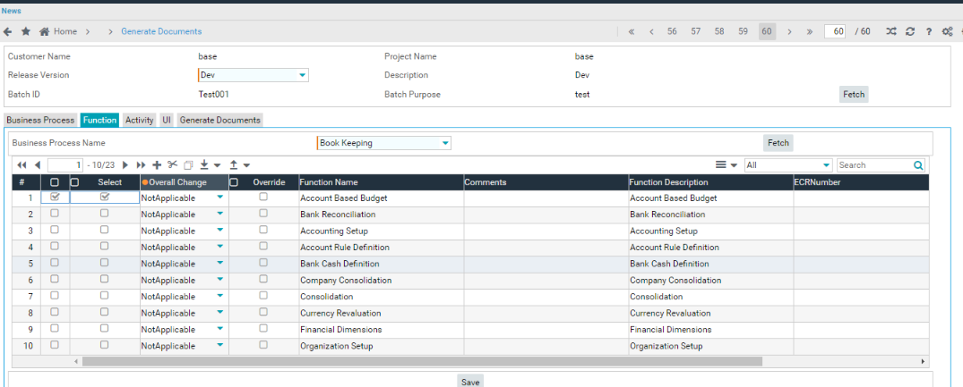
Topic 4 : Baseline
Request to have the ECR validation during the save itself ( earliest known point) [Tech Backlog Ref # : TECHB-927]
In the main model, can we have an option to choose the version names and have the ECR generated and baselined rather than multiple steps
Validation in Save

Slide 13
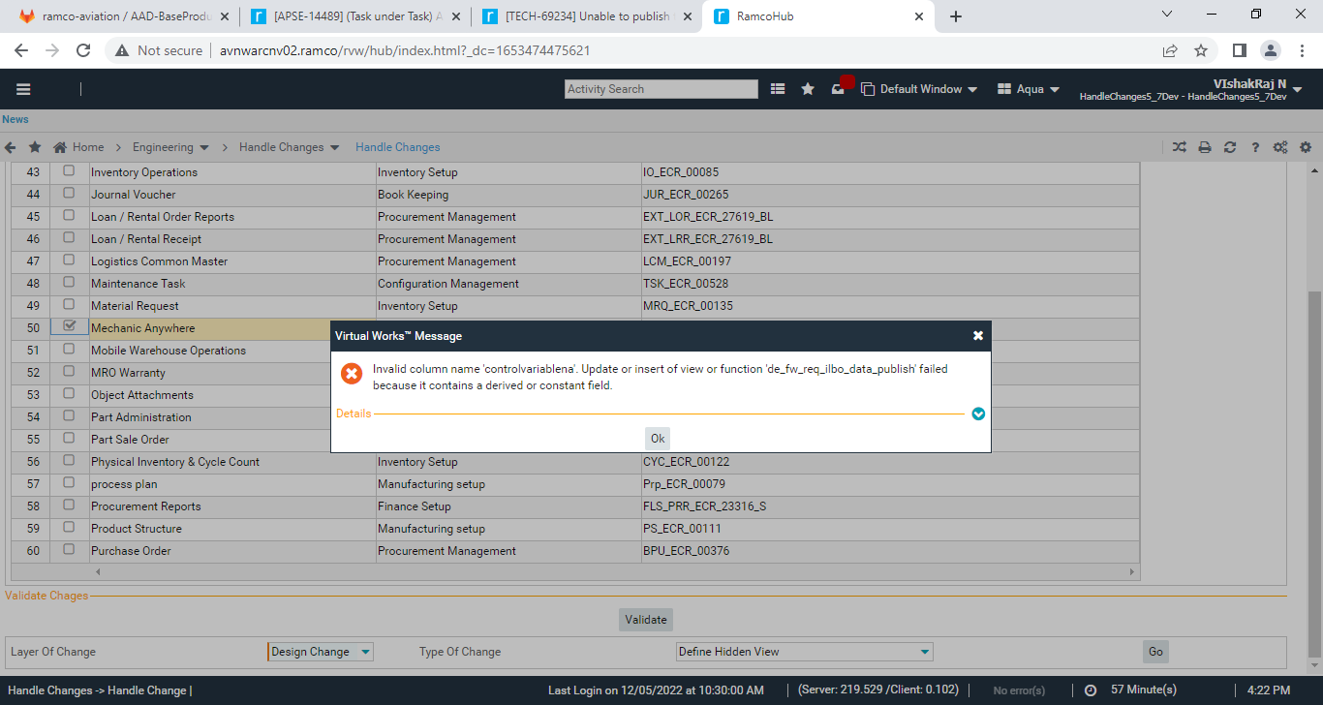
Topic 5 : Handle changes
Multiple errors / Multiple times
Without tech support, changes cannot be completed in Handle changes
Defect -1
TECH-69234 – Clarified
Notes : ECR has been validated after correcting model sp
Validate ECR

Slide 14
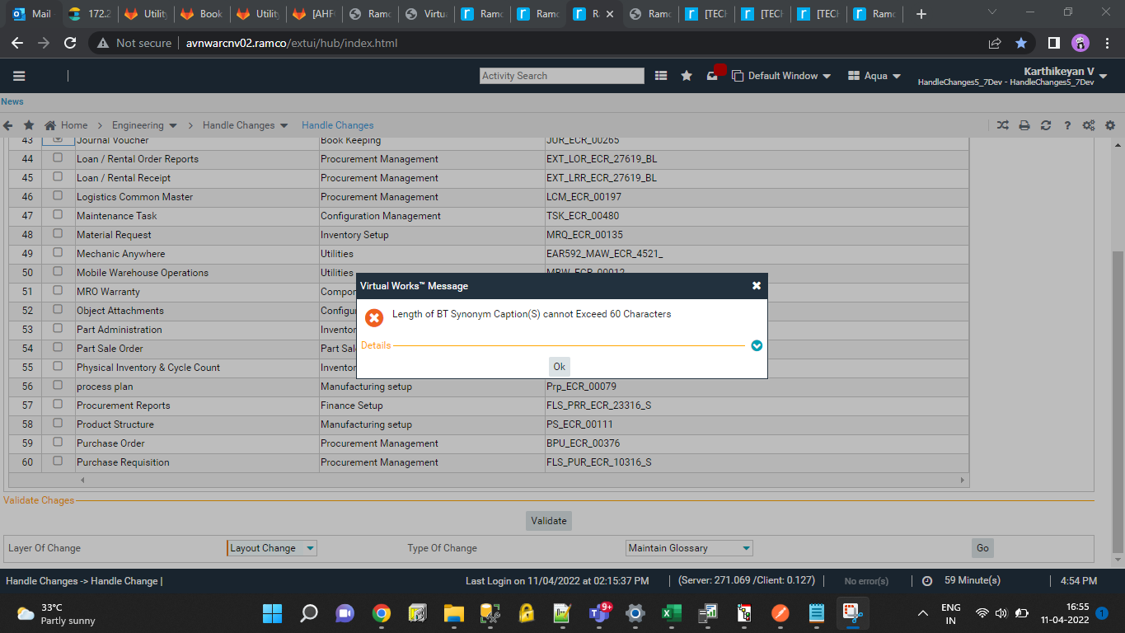
Topic 5 : Handle changes
Defect -2
TECH-67993 – Clarified
Notes : ECR is validated successfully.

Slide 15
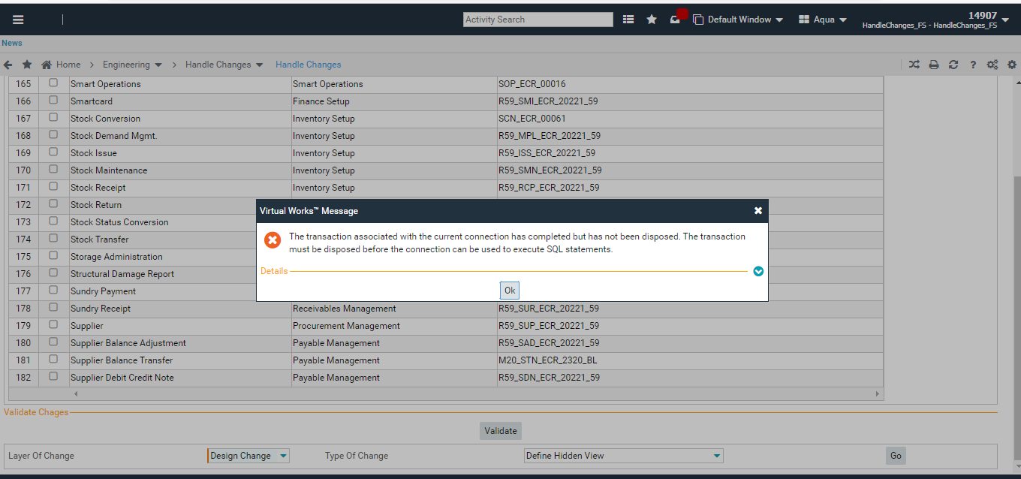
Topic 5 : Handle changes
Taking more time to validate

Slide 16
Topic 6 : Usability
ILBO – Control data association
Automatic defaults based on BT synonym
Smart search for control selection
In case of new control addition , control sequence is erratic. Solution provided to unmap the old control specific by Tech and then re-try
BR Parameter data Item
Smart search to choose the data item
Segment data Item
Default value for Segment data item based on BT synonym
[Tech Backlog Ref # : TECHB-928]

Slide 17
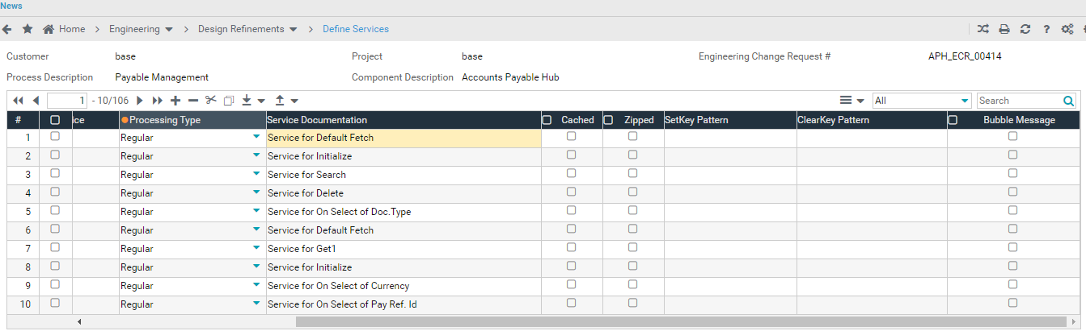
Topic 7 : Understanding/Lack of clarity
Define Services
Processing type – Regular/batch?
Cached
Zipped
Clearkeypattern

Slide 18
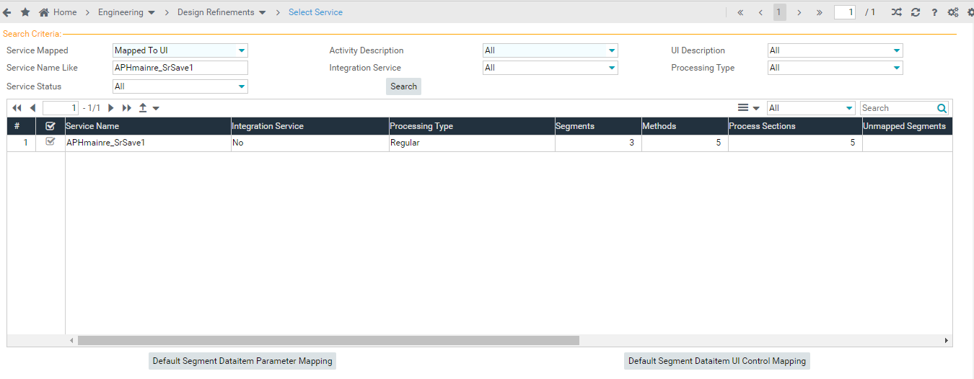
Topic 7 : Understanding/Lack of clarity
Design Refinements
Default Segment Data item Parameter mapping
Default Segment Data item UI Control mapping
Defaults – Not used

Slide 19
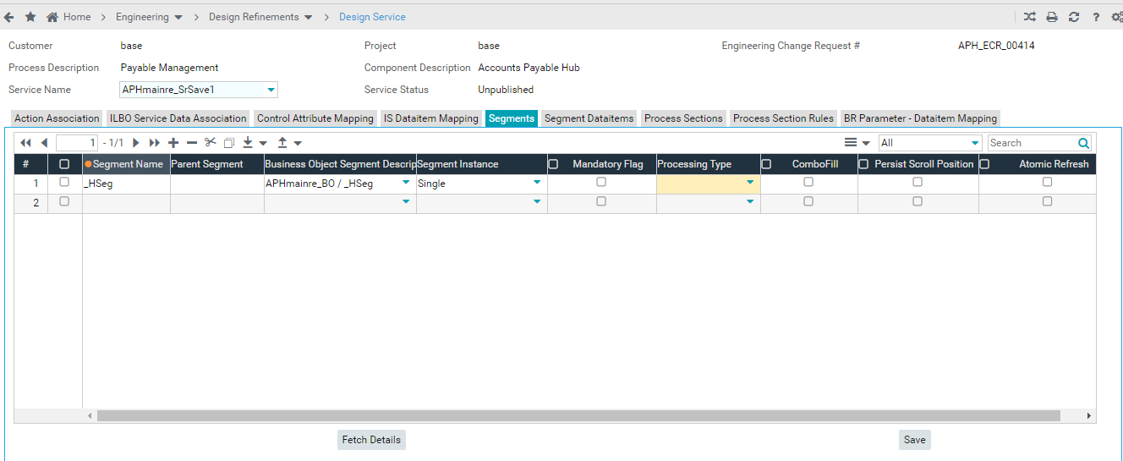
Topic 7 : Understanding/Lack of clarity
BO
Processing Type : Default/ Alternate
Mandatory Flag
Combo fill

Slide 20
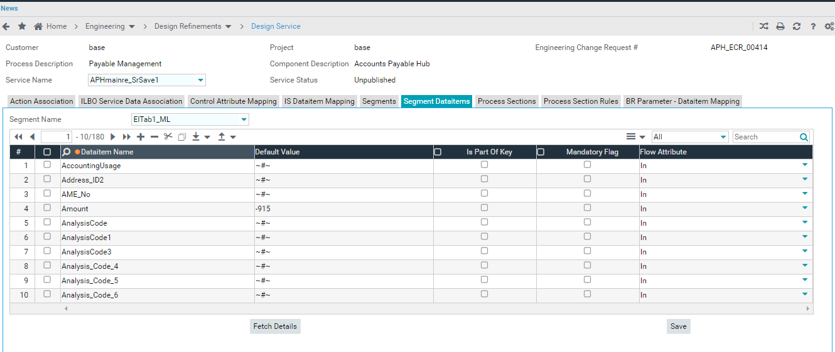
Topic 7 : Understanding/Lack of clarity
Is Part of Key
Mandatory Flag

Slide 21
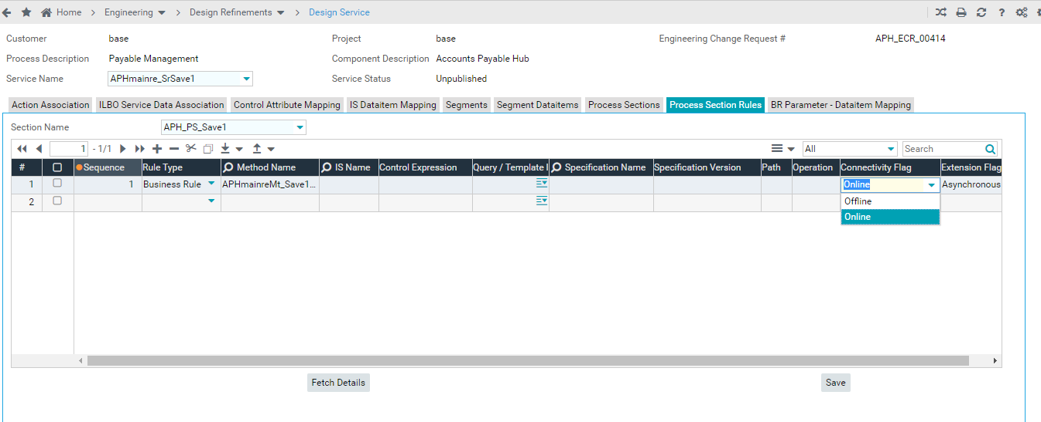
Topic 7 : Understanding/Lack of clarity
Specification version
Path
Operation
Connectivity Flag

Slide 22
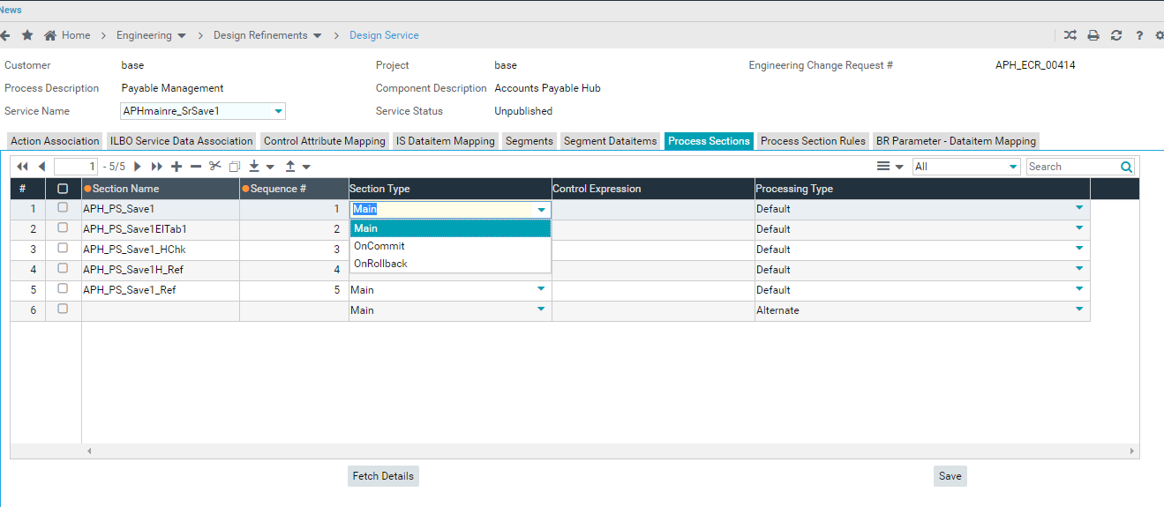
Topic 7 : Understanding/Lack of clarity
Section type

Slide 23
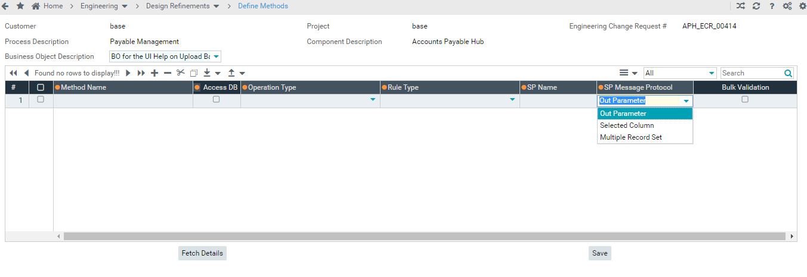
Topic 7 : Understanding/Lack of clarity
SP Message Protocol

Slide 24
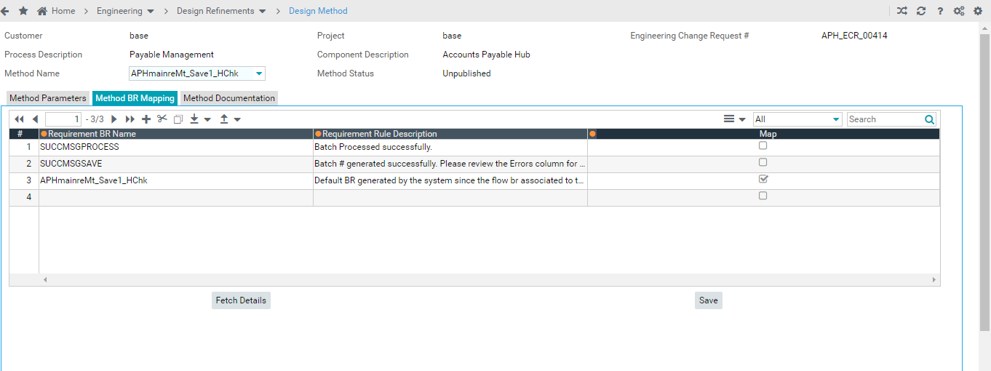
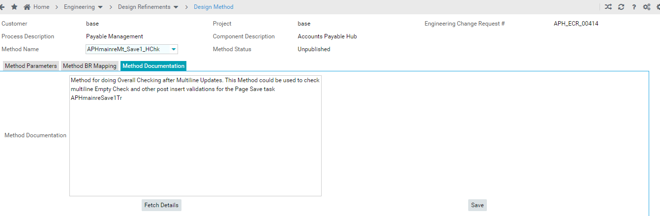
Topic 7 : Not used
Not used – Method BR Mapping/Method Documentation

Slide 25
Summary
Prioritization
Publish ECR - Validation for Codegen errors [TECHB-924]
Bulk error validation [TECHB-924]
ECR offline [TECHB-925]
Code gen offline [TECHB-926]
Handle changes error
Defaults [TECHB-928]

Slide 26
General Feedback
No documentation : Online Help & Reference manuals not maintained
New feature releases and implementation
Training is very basic , there are experts in some areas on some features

